Slide 1
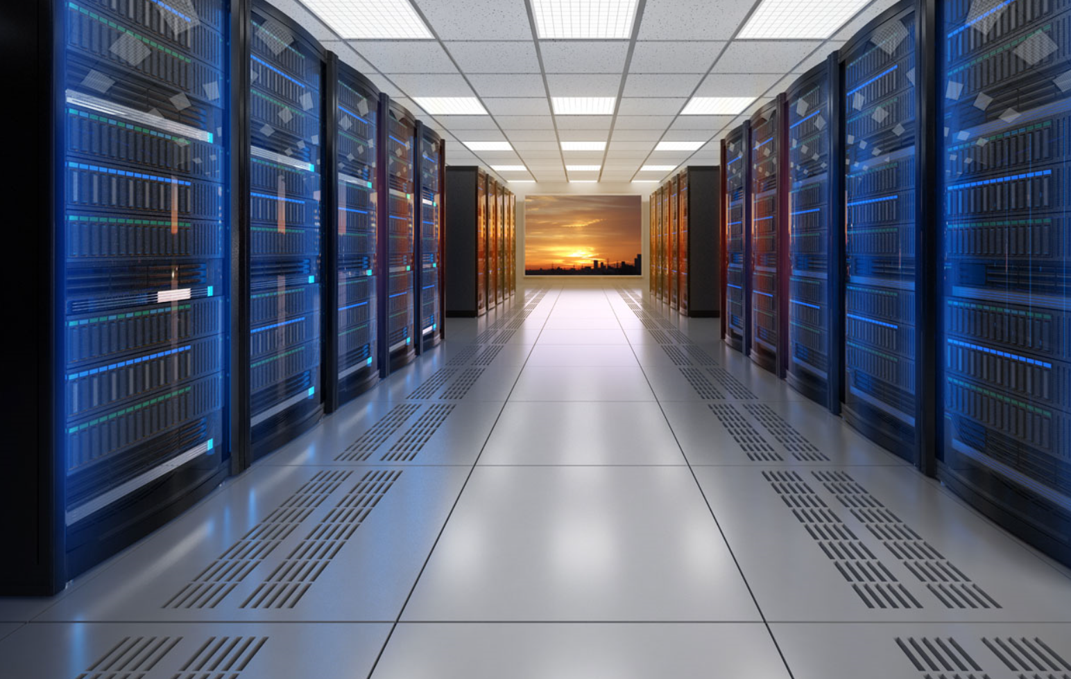
WHAT IS A DATA CENTER?

Slide 2
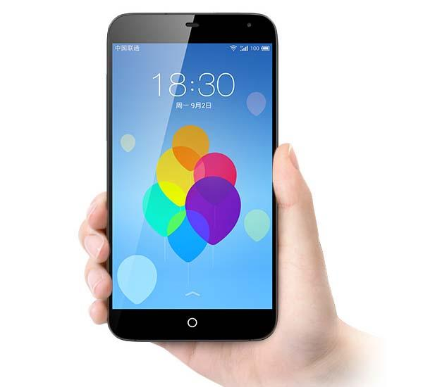
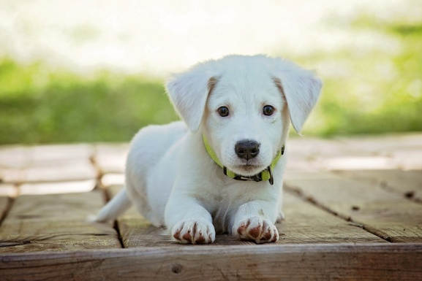
Imagine….
You have a new puppy
And, you want to show him to your friends, cousins, and grandparents.
Spot
Plus, you don’t want to lose your picture…

Slide 3
How can you show them?
Print a picture and send
Mail them your phone (JK!)
Send them a text message
Put it on Instagram!
Spot

Slide 4
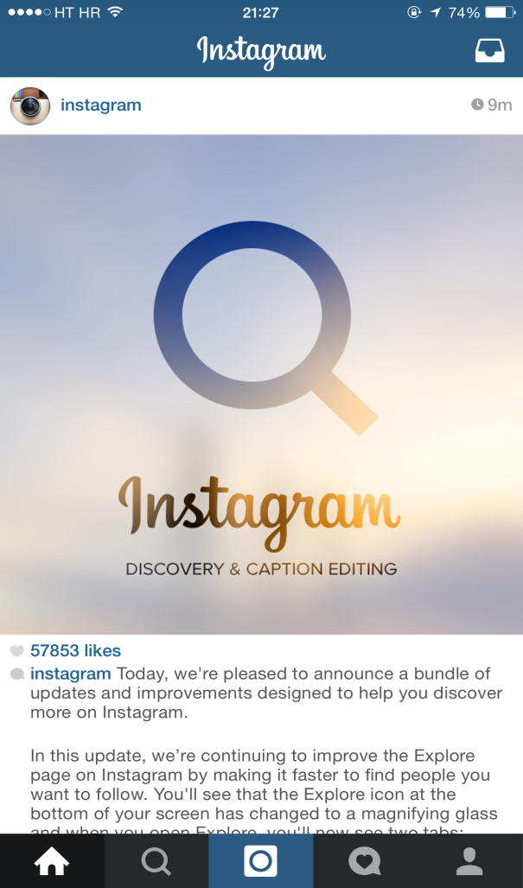

Say you pick Instagram…
Now…
All of your friends and family can see Spot.
And he is safe from getting deleted…
But…
Hey Everybody,
Here is my new puppy, Spot. Cute right?
WHERE DID SPOT REALLY GO?

Slide 5
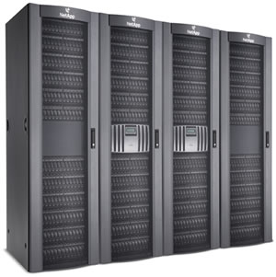

MYSTERY SOLVED!
Your picture of Spot now lives online…
Instagram, Facebook, Snapchat,
Twitter
and all sorts of companies store billions of people’s stuff on super cool, super secure computers.
These computers, which are about the size of a pizza box, are stacked in special lockers called Racks.

Slide 6
And these Racks are lined up row after row in big, well-guarded, air-conditioned buildings called…
DATA CENTERS!

Slide 7
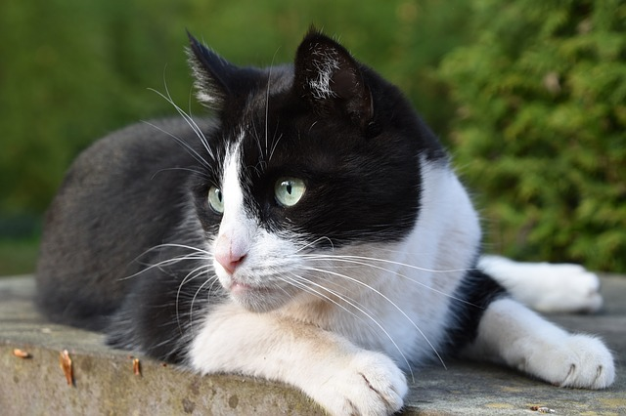
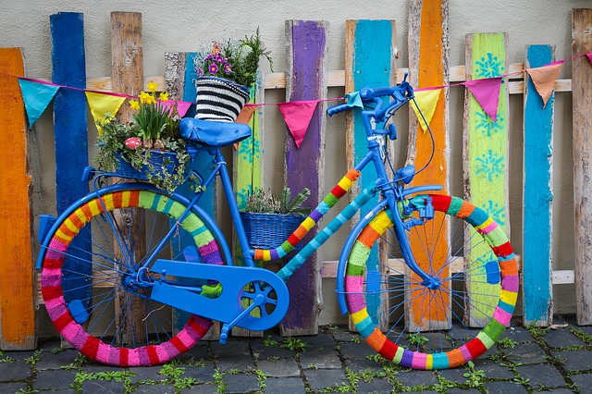
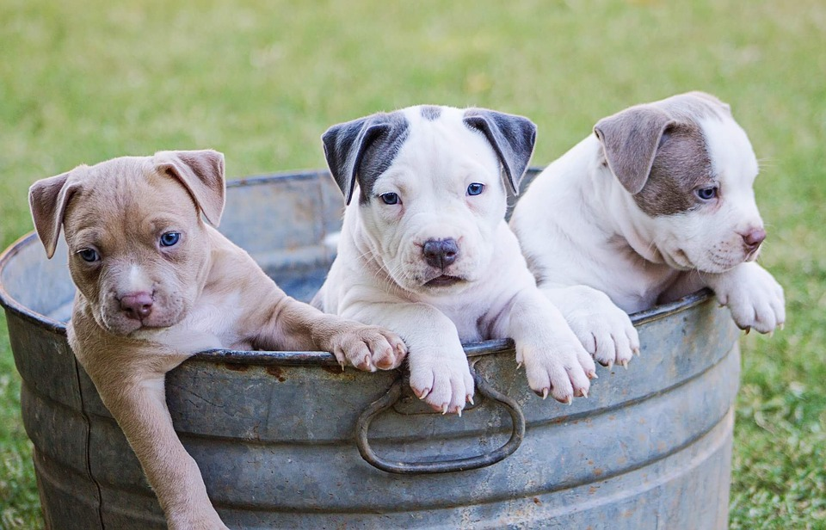



Fun Fact: There are approximately 3.2 Billion photos shared on the Internet every day!
That’s almost 1.2 Trillion per year!

Slide 8
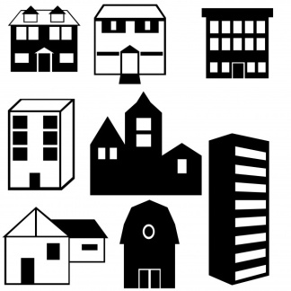












There are Data Centers all over the world!
Built in different sizes and designs…
Some may even be built underwater!
Fun Fact: More data has been created in the last two years than in the entire previous history of the human race.

Slide 9
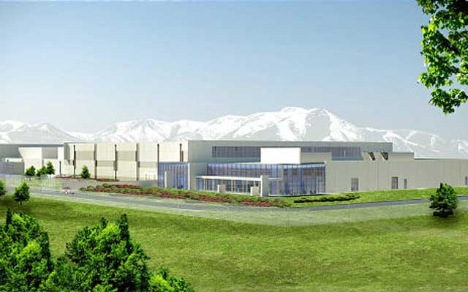
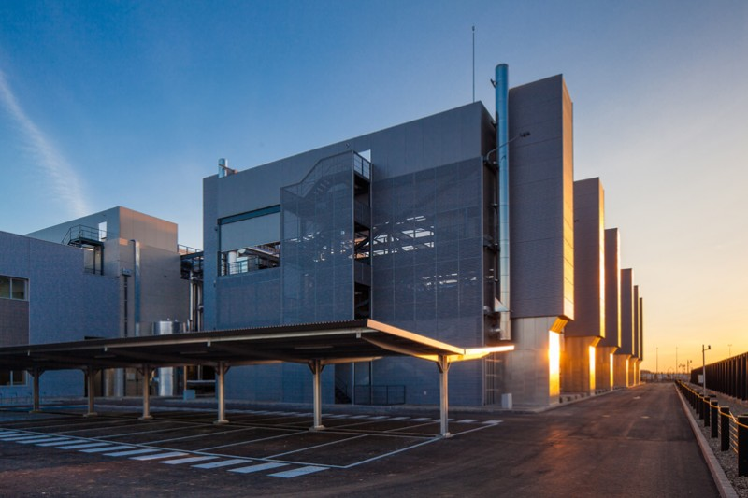
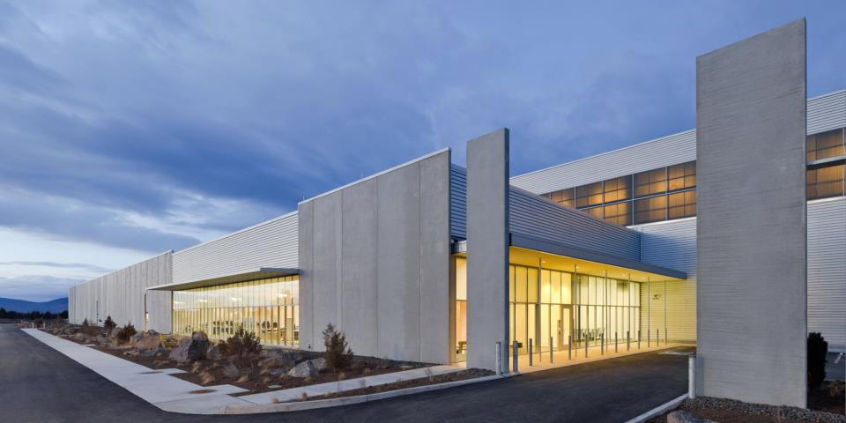
They generally look like this…

Slide 10
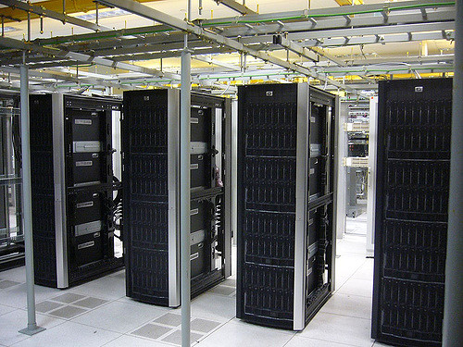
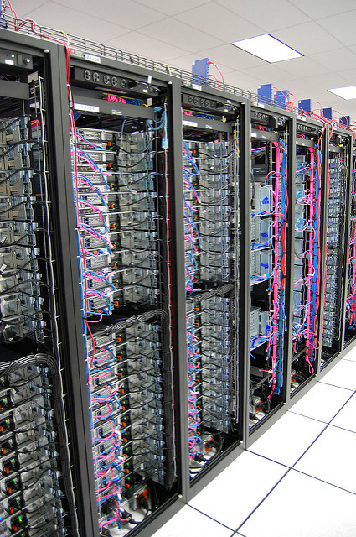
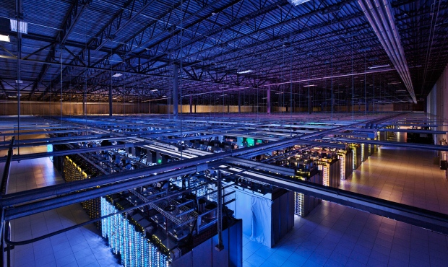
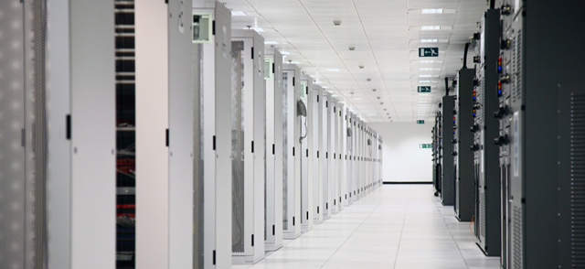
And inside…

Slide 11
They’re so cool…
Computers generate a lot of heat…
Hot Aisle
Cold Aisle
Hot Aisle
So Data Centers use state-of-the-art air control systems to keep the computers running cool.

Slide 12
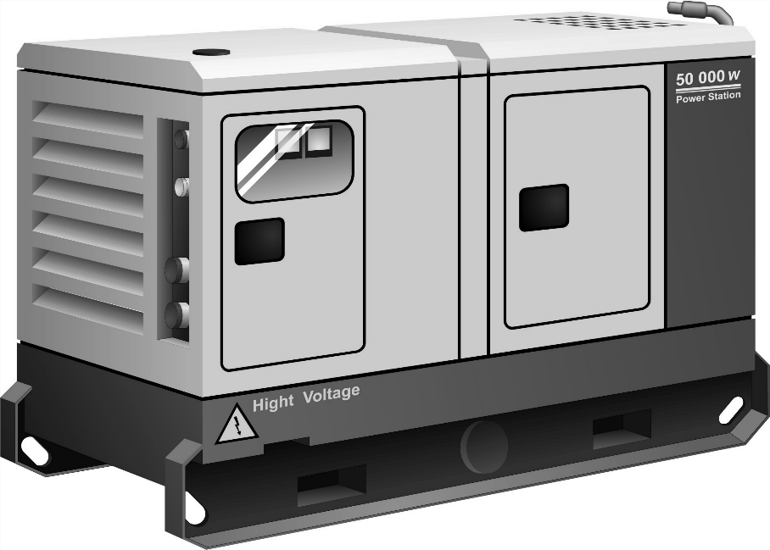
and they’re always on…
Big generators keep Data Centers running in case of power outages.

Slide 13
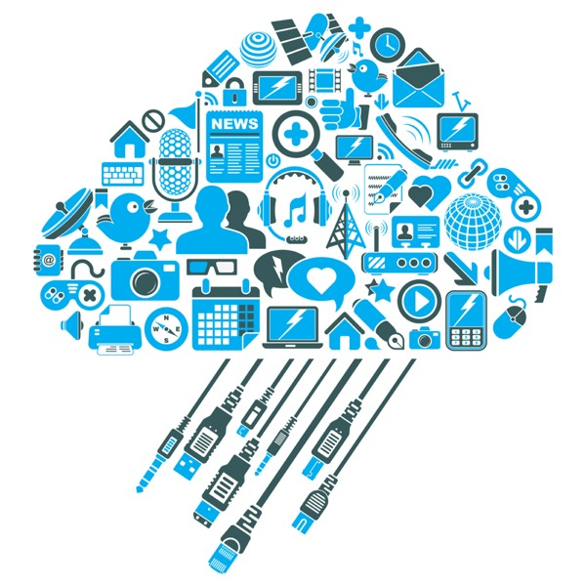
By the way…
Data Centers also help to support…
The Cloud
Extra Reading
https://www.kidscodecs.com/cloud/

Slide 14

BUT THAT’S NOT ALL!

Slide 15

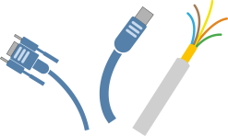





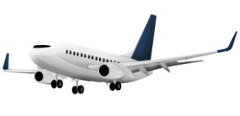
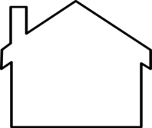


Data Centers have needs…
Power
Water
Electricity
High Speed Cabling
Climate
Financial Support
And concerns…
Natural Disasters
Visibility
Near Transportation
Friendly Neighbors

Slide 16
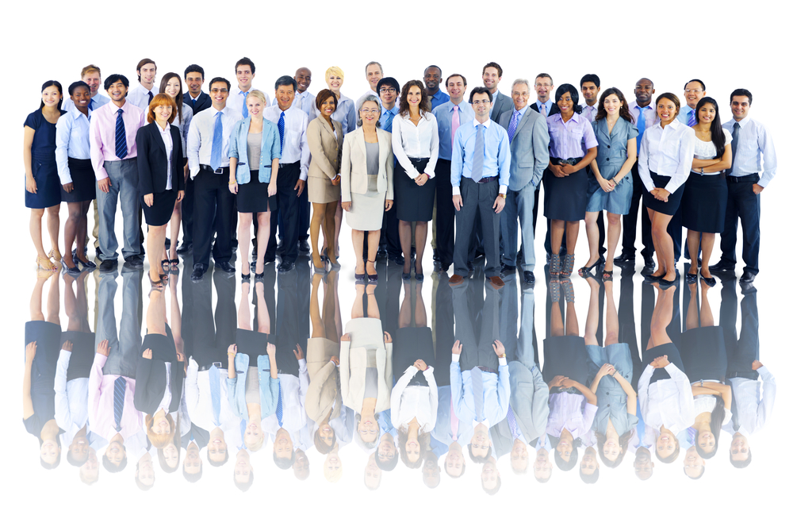
And provide lots of jobs!
Engineers of all types
Programmers
Computer Specialists
Security
Architects
Accountants
Office Assistants
Business People
Lawyers
Sales People

Slide 17
The US Dept of Labor projects 12% growth in Computer and IT occupations from 2014 to 2024.
IN FACT…
That’s faster than the average for all occupations!

Slide 18
What they do…
Computer Specialists
Make sure the computers & networks work
Engineers
Ensure the whole place runs efficiently (electricity, automation, power, air & water flow, wiring, etc.)
Lawyers
Handle contracts, regulations & legal stuff
Sales People
Architects
Design efficient buildings & offices
Sell products, services and solutions
Programmers
Write code and create cool apps!
Security
Business People
Keep the building & computers safe
Create strategy & manage the business
Office Assistants
Accountants
Help the executives run the business
Manage money

Slide 19
In Summary…
Apps store their information in Data Centers.
Companies store their data in Data Centers.
Data Centers are secure.
Data Centers use cutting edge equipment.
There are Data Centers all over the World.
All of these Data Centers help to support “the cloud.”
Data Centers are cool places to work.
There are many career opportunities in Data Centers.

Slide 20
Things to Think About
If you had to build a Data Center, where would you build it and why there?
How important are Data Centers in our everyday lives?
What do you think it would be like to work in a Data Center?
What would your Data Center look like?
What job would you want in a Data Center?

