Slide 1

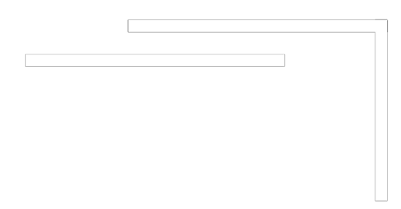


Slide 2
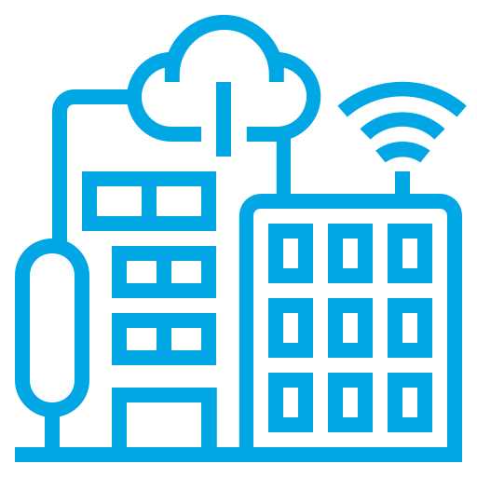


What is a
Data Center?
Why are Data Centers Important?
How to Prepare for Data Center Careers?

Slide 3
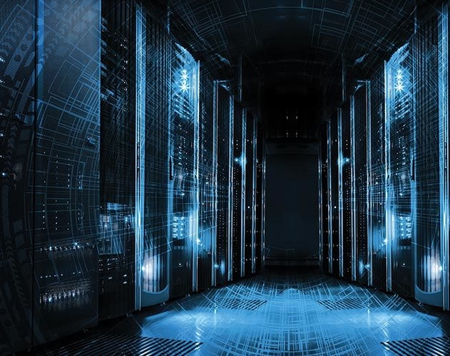

WHAT IS A
DATA
CENTER?

Slide 4
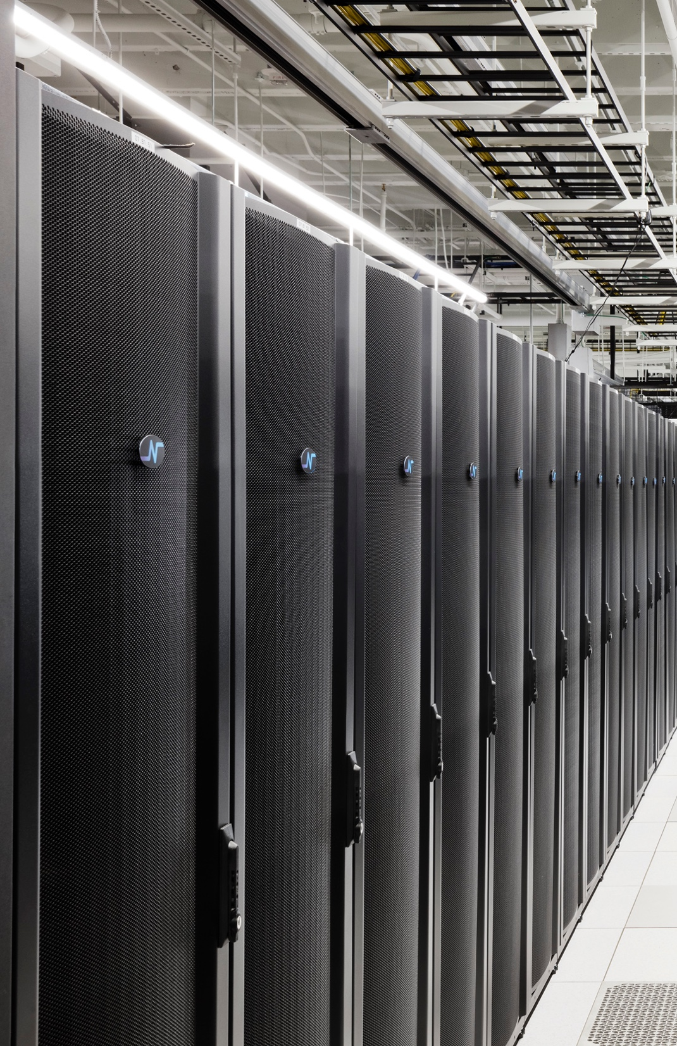
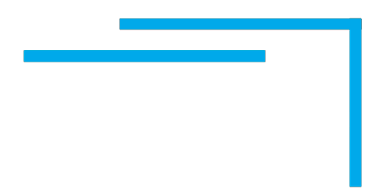
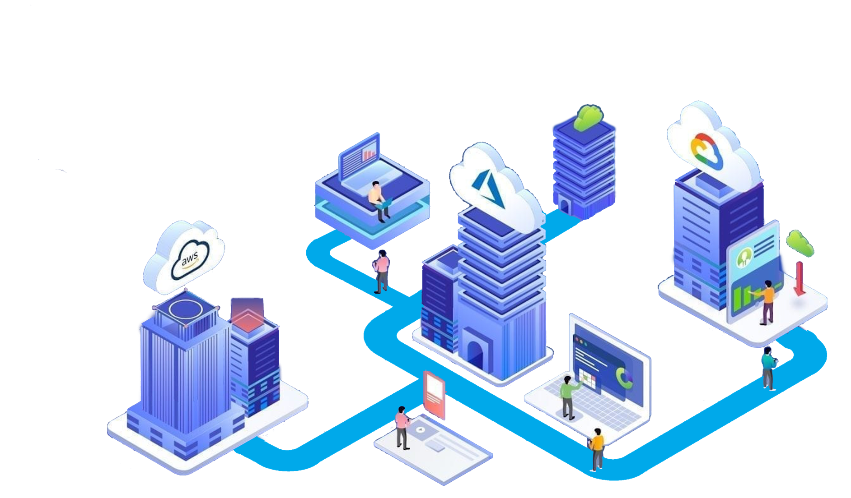
WHERE THE
INTERNET LIVES

Slide 5


DATA CENTERS ARE
WHERE THE
INTERNET LIVES
CENTRALIZED DATA STORAGE & PROCESSING
BACKUP AND REDUNDANCY FOR MISSION-CRITICAL DATA
SUPPORTING THE DAILY OPERATION OF BUSINESSES
THE ENGINES POWERING OUR DIGITAL WORLD

Slide 6



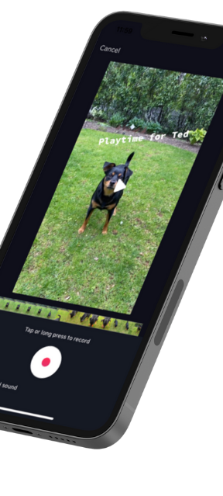








Let’s get relevant.

Slide 7
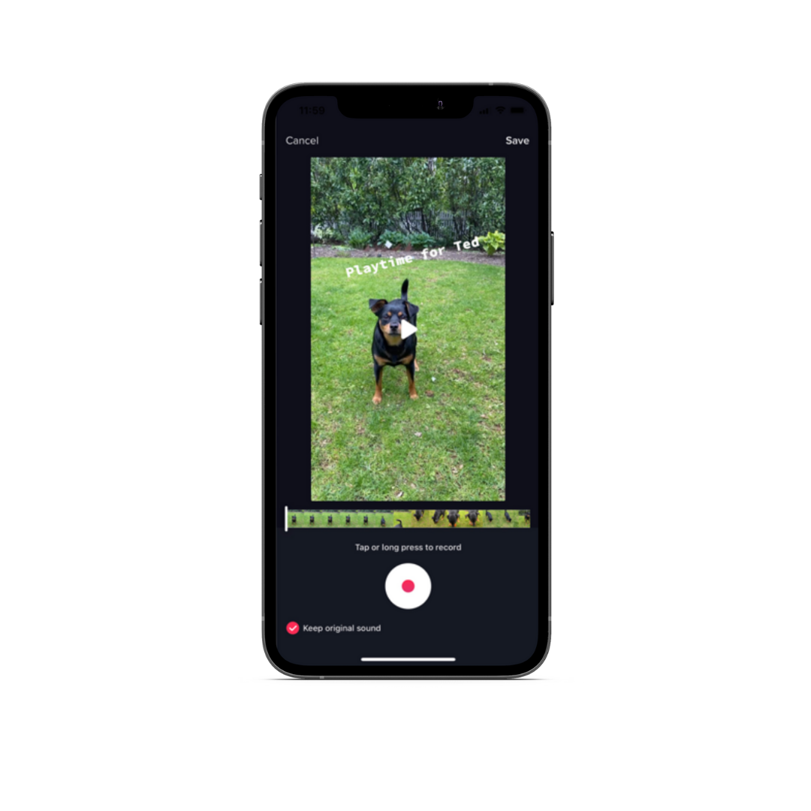

Slide 8
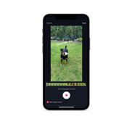
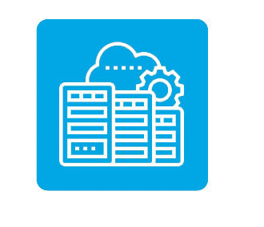

Slide 9
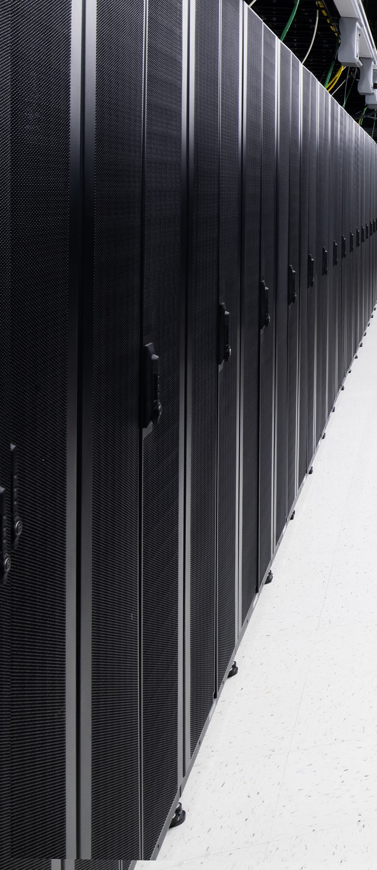
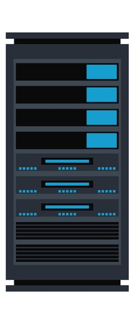

Instagram, Facebook, Snapchat,
Twitter, and every type of company store billions of people’s stuff on high-density, high-performing, and highly secure computers.
These computers, which are about the size of a pizza box, are stacked in special lockers called Racks.

Slide 10
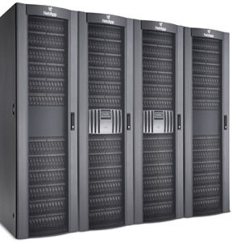

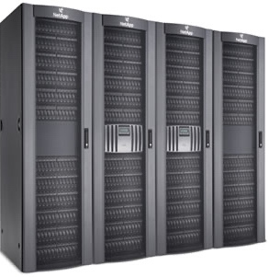

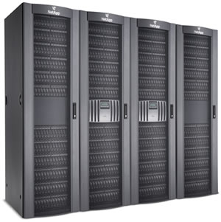
And these Racks are lined up row after row in big, well-guarded,
air-conditioned buildings called…
DATA
CENTERS

Slide 11
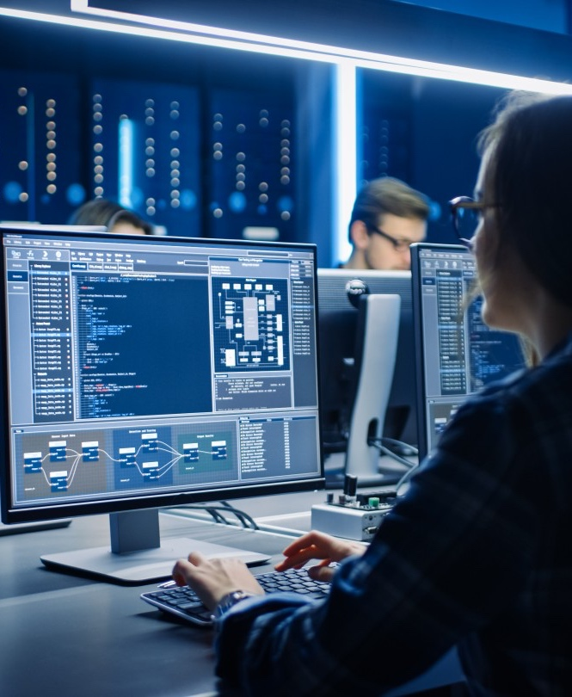

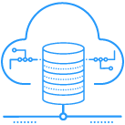







Gaming
Service Providers
Oil & Gas
Engineering
Healthcare
Higher
Education
Media &
Content
Financial
Services
Government &
Public Sector

Slide 12

WHERE ARE
DATA CENTERS
LOCATED?

Slide 13
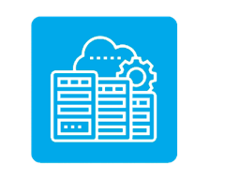
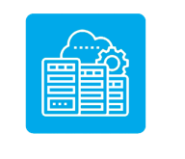
There are Data Centers all over the world!
Built in different sizes and designs…
Some may even be built in space!

Slide 14
Fun Fact: By the end of 2021,
79 zettabytes of data was generated worldwide which is equivalent to more than all the visible stars in the universe — 72x.
What Happens in an Internet Minute:
$283,000
Spent by Amazon Customers
6 Million
People Shop Online
12 Million
People Send an iMessage
65,000
Instagram Photos Shared
167 Million
TikTok Users Watch Videos

Slide 15
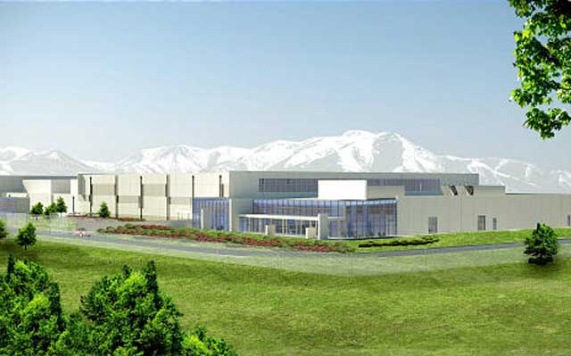
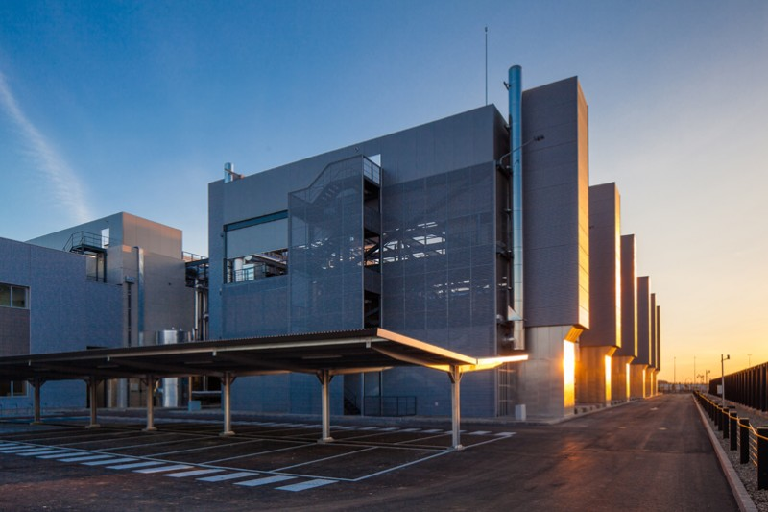
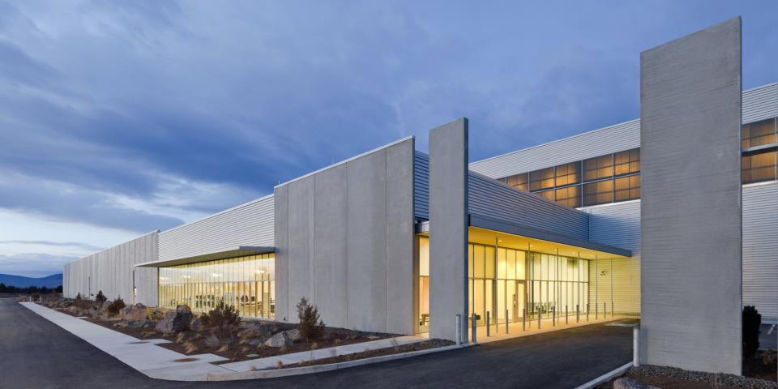
THEY GENERALLY LOOK LIKE

Slide 16
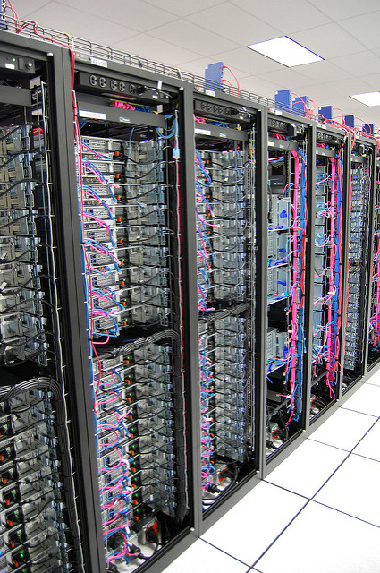
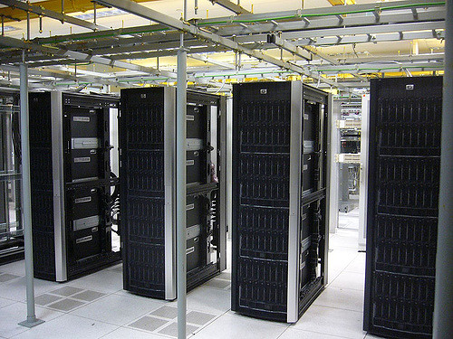
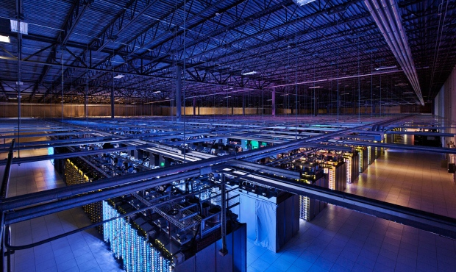
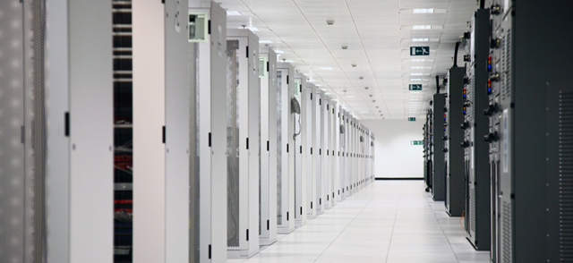
AN
INSIDE LOOK

Slide 17
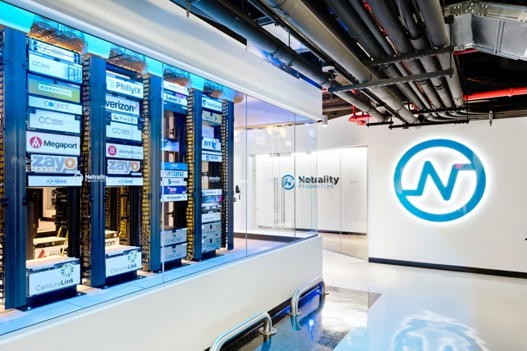
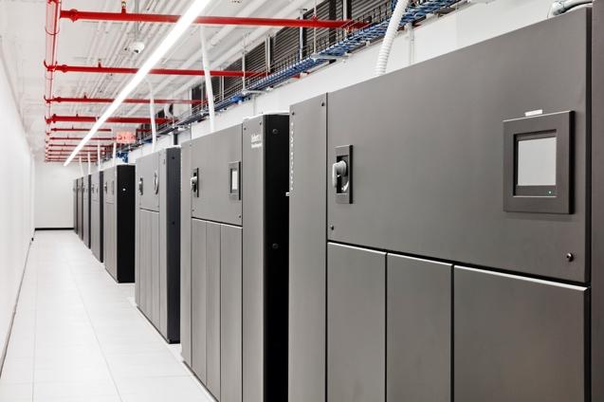
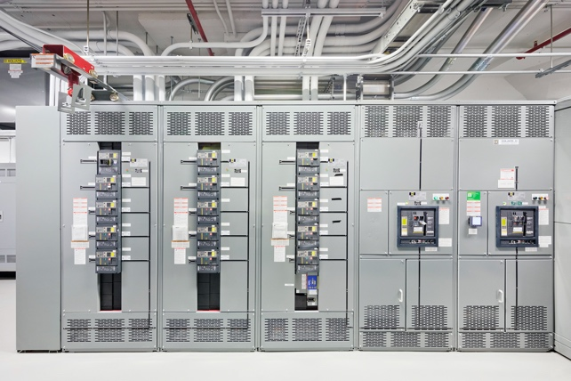
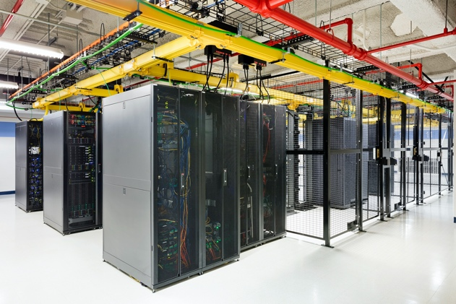
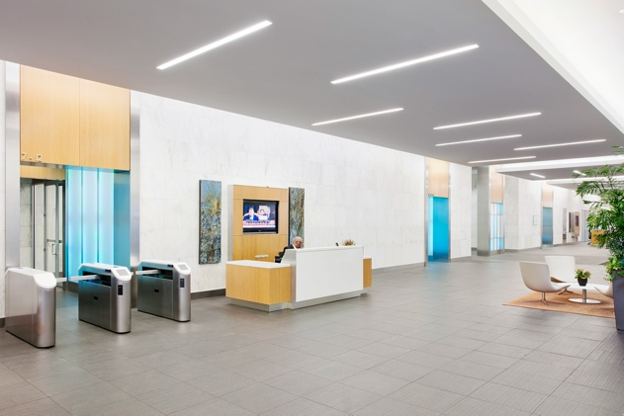
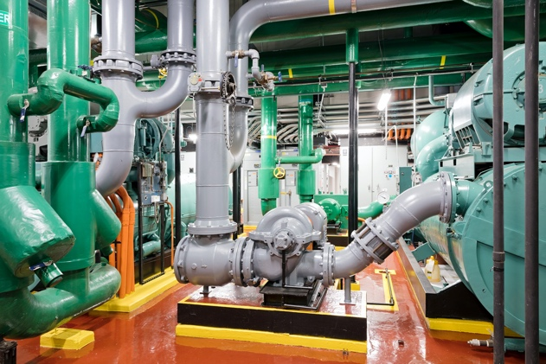
TAKE A PEEK INSIDE
Colocation, Meet-Me-Room, and NOC
CRAC Units
Electrical/ UPS
Colocation
Mixed-use Buildings
Generators and Chillers

Slide 18
KEEPING IT COOL
Computers Generate a Lot of Heat…
Hot Aisle
Cold Aisle
Hot Aisle
So Data Centers use state-of-the-art air control systems to keep the computers running cool.
10 – 1,000 Watt Microwaves/Cabinet
1,667 – 6 Watt LED Light Bulb

Slide 19

Data Centers Also Help Support…
The Cloud
Extra Reading
www.kidscodecs.com/cloud/

Slide 20
DATA CENTERS HAVE
NEEDS

Slide 21
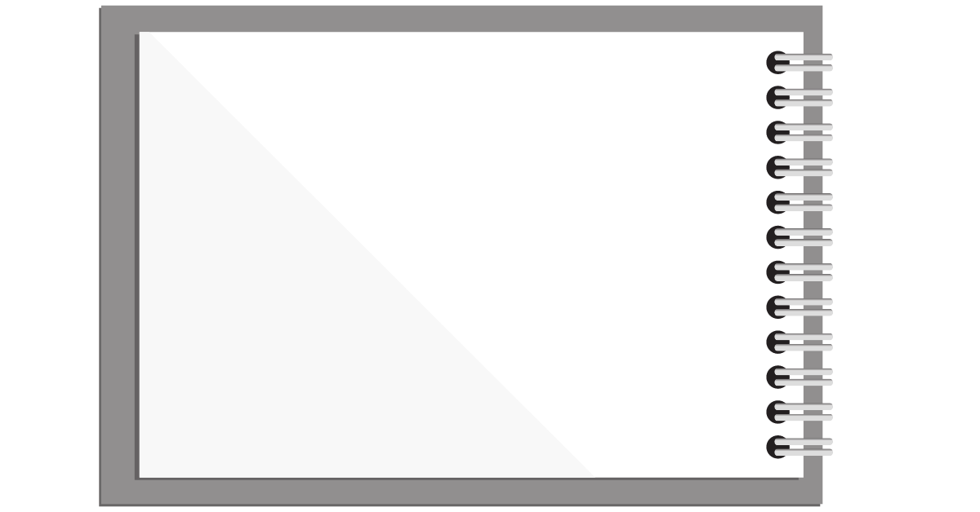


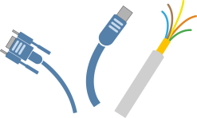
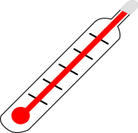



DATA CENTER
NEEDS
Power
High Speed
Cabling
Water
Climate
Electricity
Financial
Support

Slide 22
DATA CENTERS HAVE
CONCERNS

Slide 23
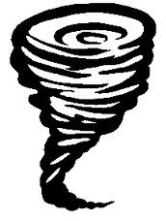


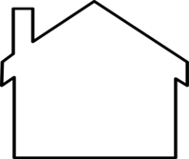

DATA CENTER
CONCERNS
Natural Disasters
Visibility
Near Transportation
Friendly Neighbors

Slide 24





SUSTAINABILITY &
ENERGY EFFICIENCY

Slide 25
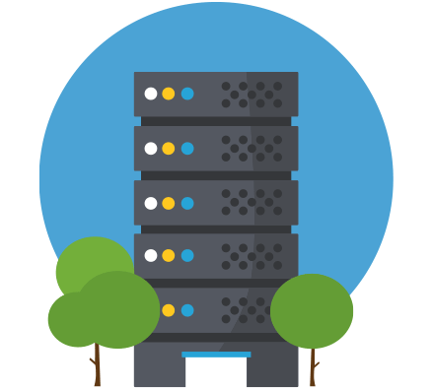
SUSTAINABILITY &
ENERGY EFFICIENCY
Reduce Energy By:
Water Reduction by:
Increasing the room temperatures
Lower humidity set points or eliminate humidification
Use lighting controls to turn off lights in areas without occupants
High-efficient transformers and UPS modules
LED lighting – targeted locations
Free cooling on the mechanical systems (pumped refrigerant, air or water side)
Use water cooled mechanical equipment
CFD study to determine possible airflow reductions.
Hot/cold aisle containment
Using air cooled equipment
Rainwater harvesting for cooling tower makeup water
Lower humidity set points or eliminate humidification

Slide 26


CONSIDER A CAREER IN
DATA CENTERS!

Slide 27
DID YOU KNOW
Most STEM workers have a college degree, but not everyone. 29% of STEM workers have a master’s degree, 36% have a bachelor’s degree, and 35% have less than a bachelor’s degree (associates, some college, or high school)*
During the COVID-19 pandemic, we relied on technology more than ever. Because of this demand, STEM jobs are expected to grow 10.5% between 2020 and 2030*.
The US Dept of Labor projects 12% growth in Computer and IT occupations from 2014 to 2024.
The number of staff needed to run the world’s data centers will grow by 300k in the next 3 years*. That’s faster than the average for all occupations!
*Sources: Pew Research Center, US Bureau of Labor Statistics, Uptime Institute

Slide 28
HAVE A KNACK FOR…
Hands-on Work:
Software & Computer Skills:
Data Center Technicians
Electrical wiring
Tech configuration
Security system development
Building Engineers
Ensure facilities run efficiently
Work with electricity, automation, power, air & water flow, wiring, etc.
Overall building maintenance
Security
Keep buildings and computers safe
IT Specialist
Tech support and network maintenance
Cyber security
Digital Content Creator
Promote company brand
Manage and expand social media presence
Maintain company website
Utilize SEO to increase traffic to company sites
Programmer
Write coding
Create apps

Slide 29
HAVE A KNACK FOR…
Math/Money Management:
Negotiation/Interpersonal Skills:
Accounting and Financial Planning
Money management
Financial reporting and budgeting
Accounts Receivable Specialist
Expense tracking
Maintain records of payment and collections
Property Management
Real estate
Tenant contracts and legal documents
Business Development
Sales
Building and maintaining customer relationships
Marketing
Event planning
Develop and distribute company promotional materials
Organize networking events
People Operations
Recruiting and Benefits
Culture and Inclusion
Workforce development and training

Slide 30
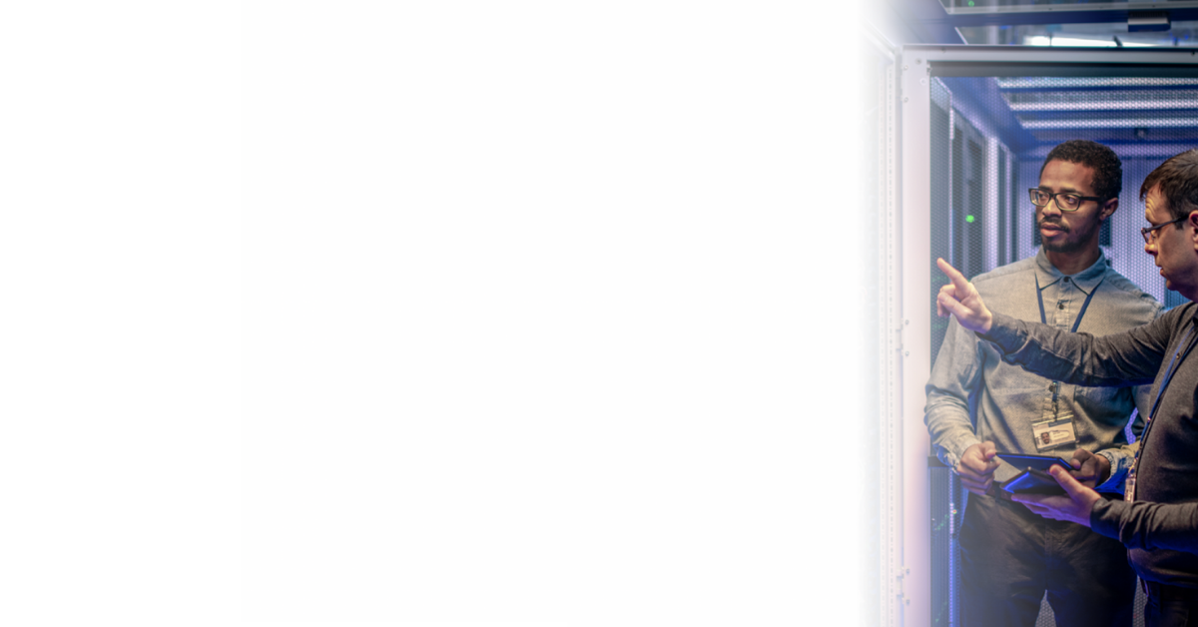
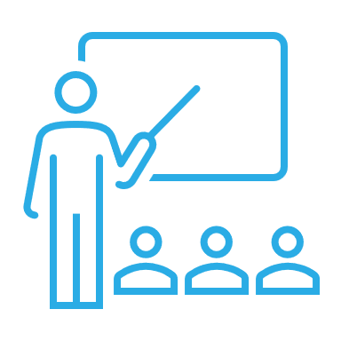


HOW TO PREPARE
COURSES
CAREER PREPARATION
AutoCAD and shop courses
Excel and computer science courses
STEM Courses
Build your resume – many free tools online!
Join LinkedIn
Free interest-specific LinkedIn courses
Seek out internship opportunities
HIGHER EDUCATION
MENTORSHIP/CLUBS
Bachelor’s degree for careers in accounting, business
Associates degree for careers in engineering, computer science
Not required for most careers in technician work, security, and IT
Interest-specific school clubs
Seek out mentorship opportunities with teachers in subject of interest
Meet with guidance counselor or advisor
Computer/IT groups

Slide 31

ACE
MENTOR PROGRAM
Our Mission
To engage, excite and enlighten high school students to pursue careers in architecture, engineering and construction through mentoring and to support their continued advancement in the industry.
Learn more: www.acementorphilly.org

Slide 32
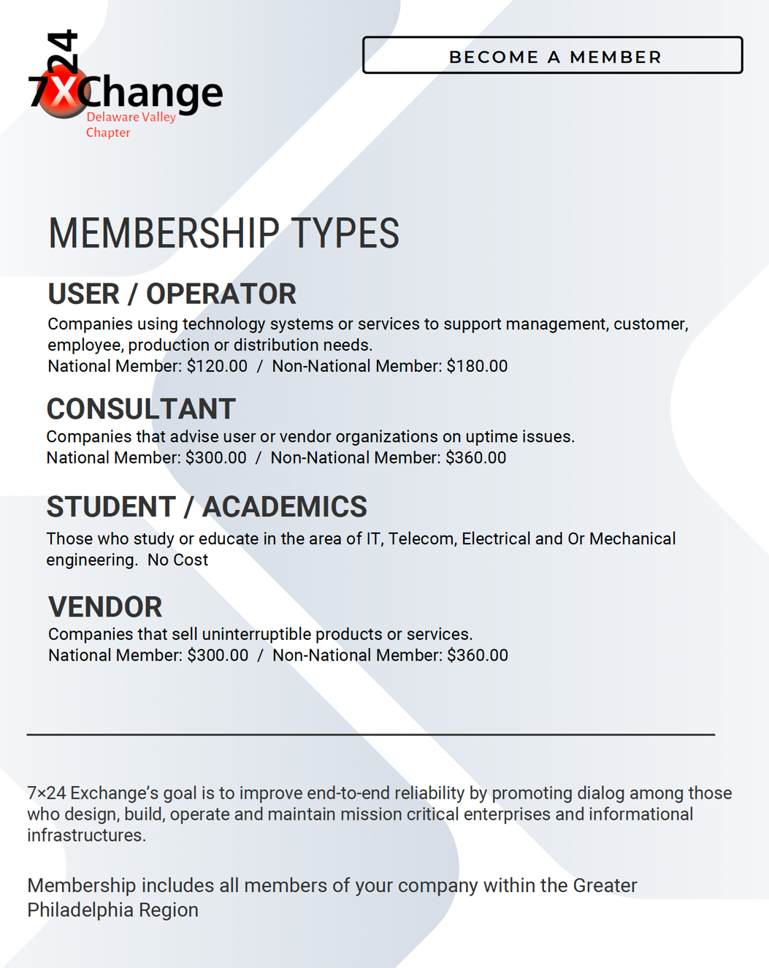
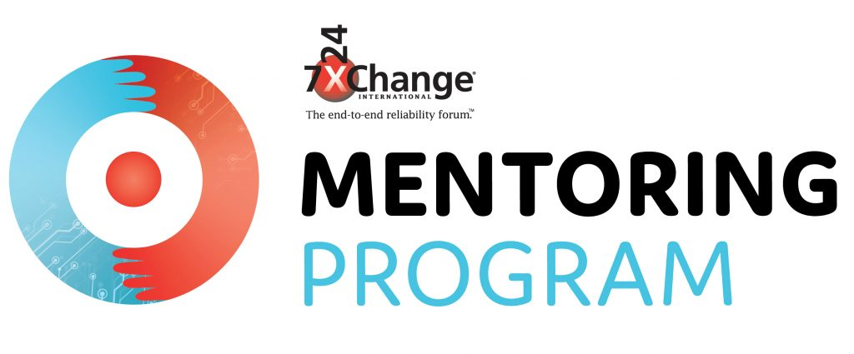
7x24
EXCHANGE
MEMBERSHIP
Mentor Program: https://www.7x24exchange.org/member-resources/mentoring/

Slide 33
IN SUMMARY
Apps store their information in Data Centers.
Companies store their data in Data Centers.
Data Centers are secure.
Data Centers use cutting edge equipment.
There are Data Centers all over the World.
All of these Data Centers help to support “the cloud.”
Data Centers are cool places to work.
There are many career opportunities in Data Centers.

Slide 34
CLASS DISCUSSION
What do you think it would be like to work in a Data Center?
If you had to build a Data Center, where would you build it and why there?
How important are Data Centers in our everyday lives?
What would your Data Center look like?
What job would you want in a Data Center?

Slide 35
