Slide 1

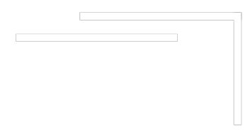


Slide 2
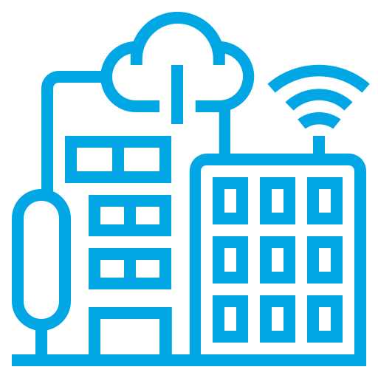


What is a
Data Center?
Why are Data Centers Important?
How to Prepare for Data Center Careers?

Slide 3
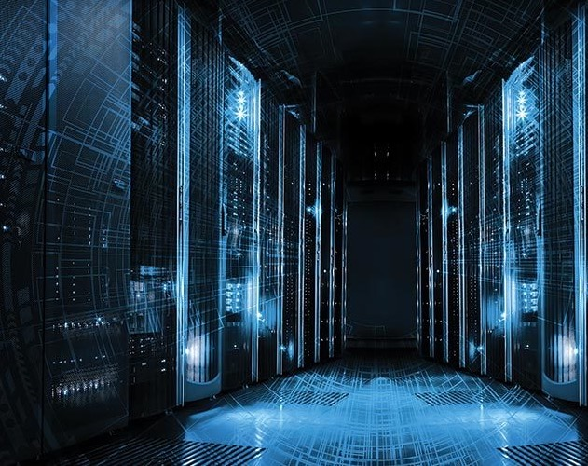

WHAT IS A
DATA
CENTER?

Slide 4
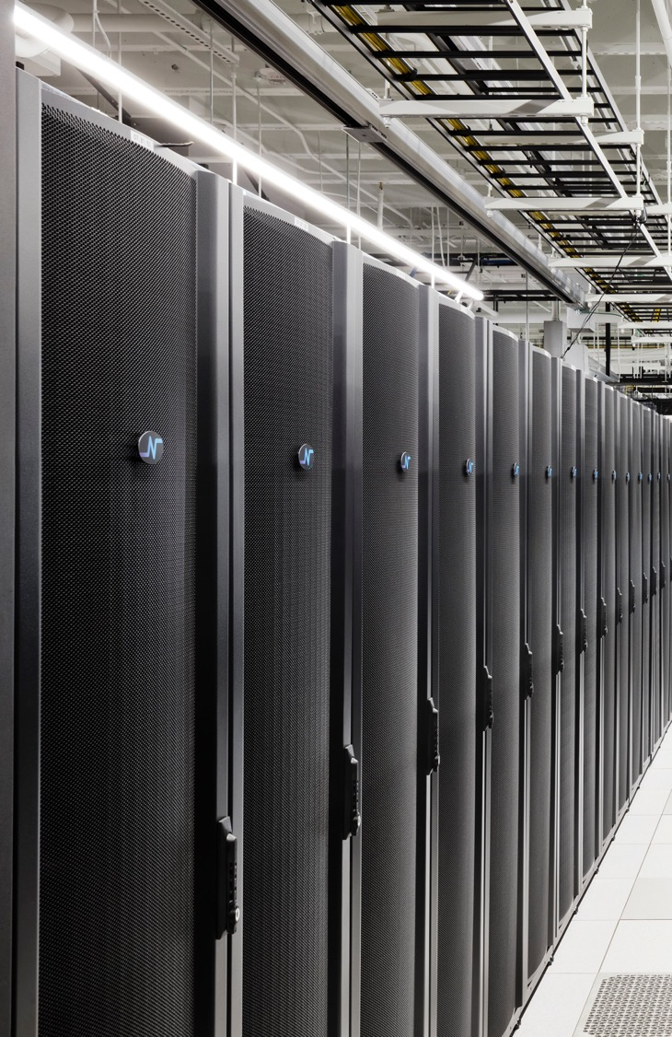
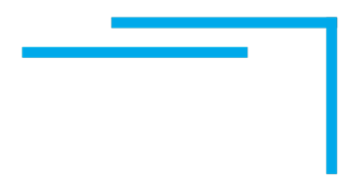
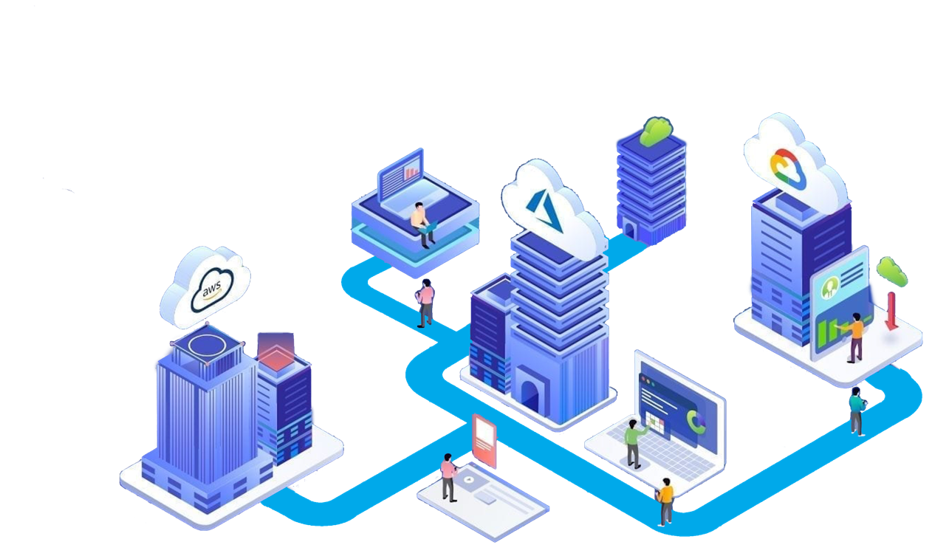
WHERE THE
INTERNET LIVES

Slide 5


DATA CENTERS ARE
HOME OF THE “CLOUD” AND ALL INTERNET TRAFFIC
CENTRALIZED DATA STORAGE & PROCESSING
BACKUP AND REDUNDANCY FOR MISSION-CRITICAL DATA
THE BACKBONE OF THE DAILY OPERATION OF BUSINESSES
THE ENGINES POWERING OUR DIGITAL WORLD
Notes:
Discuss diff verticals

Slide 6
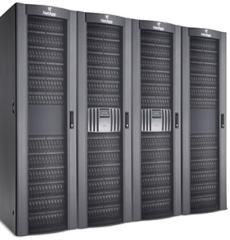
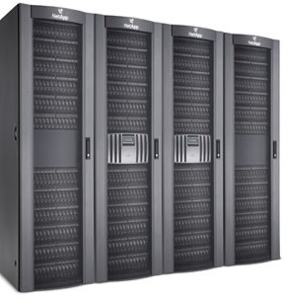
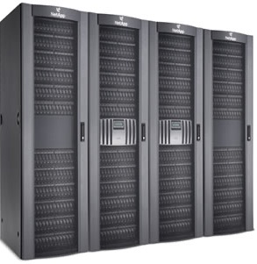
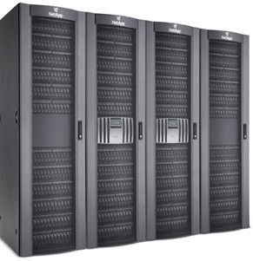
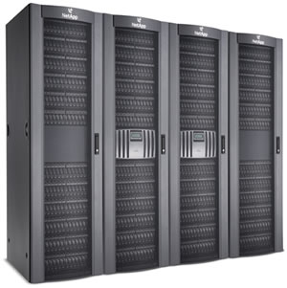
Computers (servers) are stacked in specially designed storage lockers called Server Cabinets or Racks.
These Racks are hosted in highly secured, well air conditioned, robustly powered facilities called DATA CENTERS.
Notes:
All disparate IT systems (DCIM ERP CRM 365) to be integrated points and EACH accessing the same data which in turn will be the same data taht is accessed by all stakeholders Investors, the mgmt team, and our customers.

Slide 7
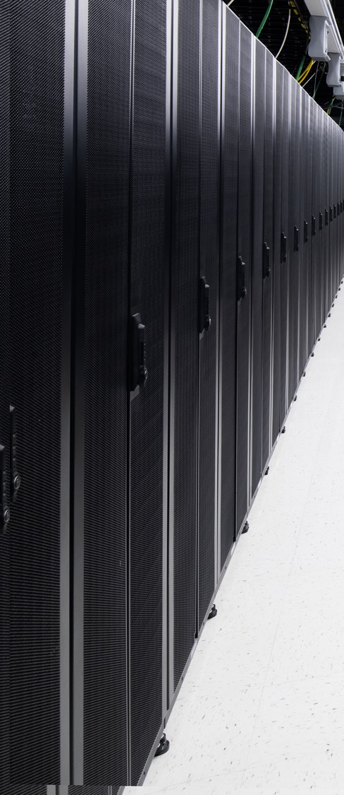
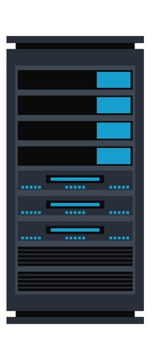

Companies like Instagram, Facebook, Snapchat,
Twitter, and many others store billions of people’s information on numerous high-density, high-performing, and highly secure servers.
In order to always have access to the information on these servers, companies host their equipment in well connected data centers, mostly run by a third-party facility management team like Netrality.
When multiple companies lease space within a shared data center this is referred to as COLOCATION.
Customers of all varieties can lease out space in a Data Center, from a single Rack to a dedicated cage, or even a stand-alone suite.
Notes:
Instagram, Facebook, Snapchat,
Twitter
and all sorts of companies store billions of people’s stuff on super cool, super secure computers.

Slide 8
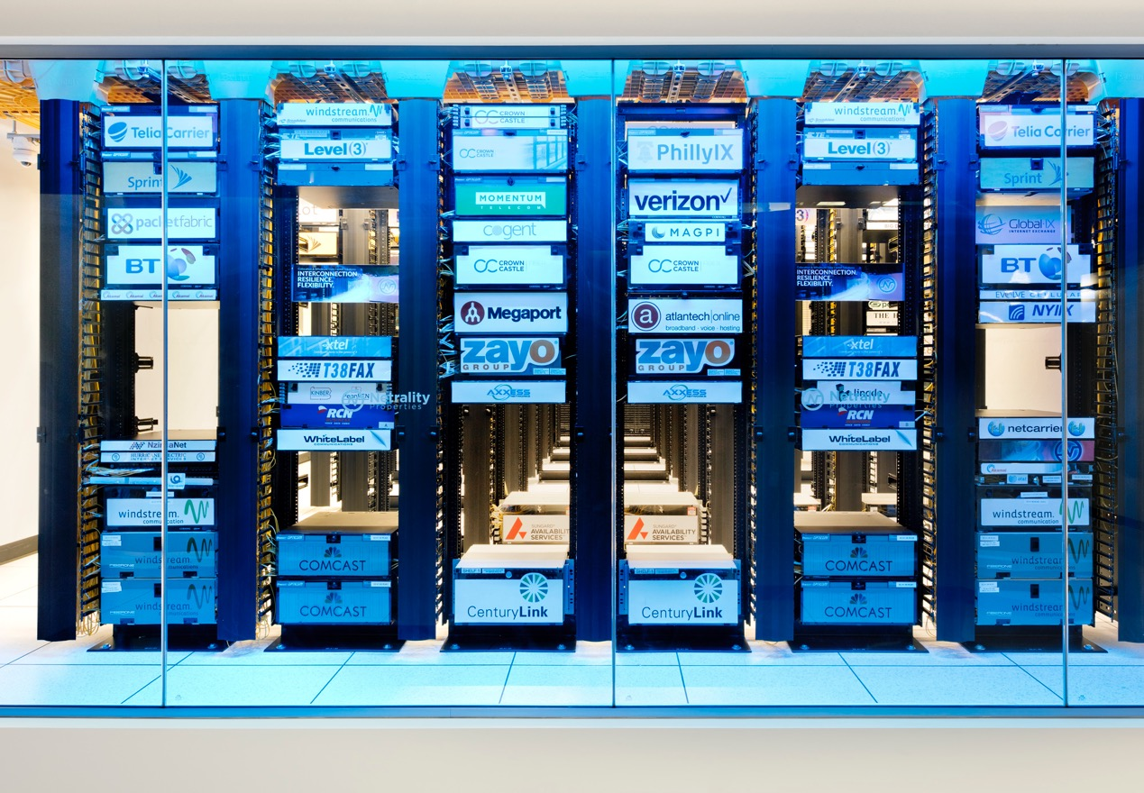
In a COLOCATION data center, customers have an added benefit of interconnecting with the other customers hosted within the same facility.
This interconnecting typically occurs through fiber optic cables within a restricted access room known as a
MEET-ME-ROOM or
MMR.
Extra Reading
https://teecom.com/what-is-a-meet-me-room/

Slide 9









Data Centers Also Help Support…
Gaming
Healthcare
Engineering
Media &
Content
Higher
Education
Oil & Gas
Government &
Public Sector
Financial
Services
The Cloud
Extra Reading
https://edu.gcfglobal.org/en/computerbasics/understanding-the-cloud/1/

Slide 10
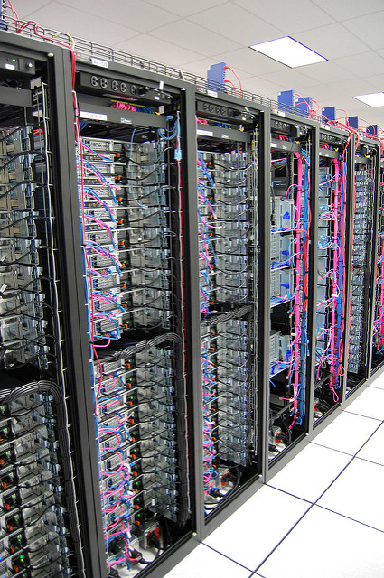
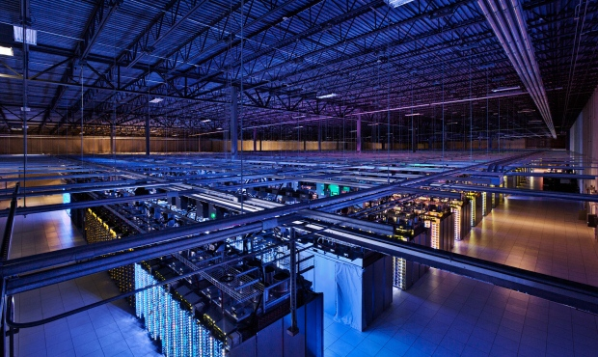
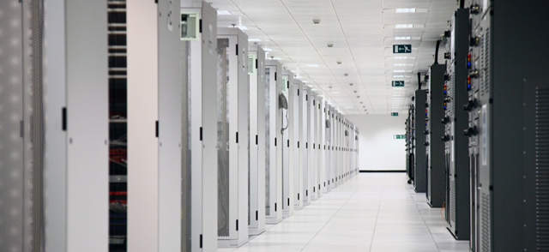
Data Centers come in many different styles of design and engineering philosophies.

Slide 11
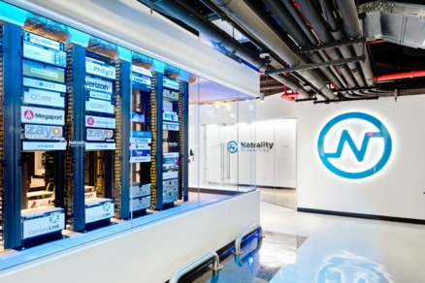
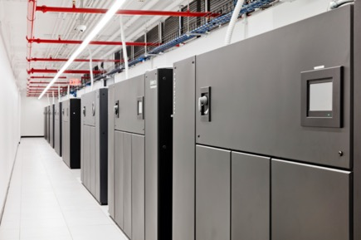
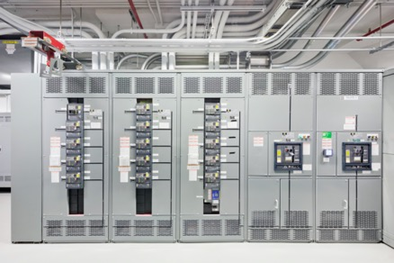
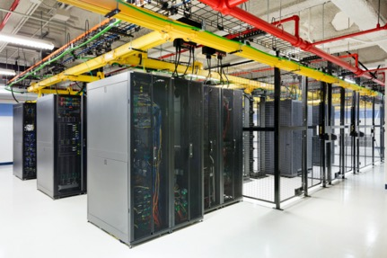
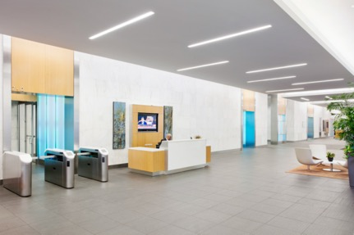
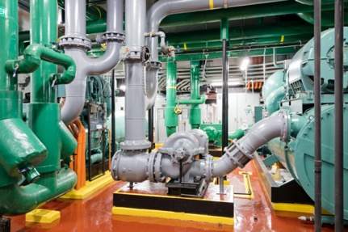

TAKE A PEAK INSIDE
Meet-Me-Room, and NOC
CRAC Units
Electrical/ UPS
Colocation
Mixed-use Buildings
Generators and Chillers

Slide 12
DATA CENTERS HAVE
NEEDS

Slide 13
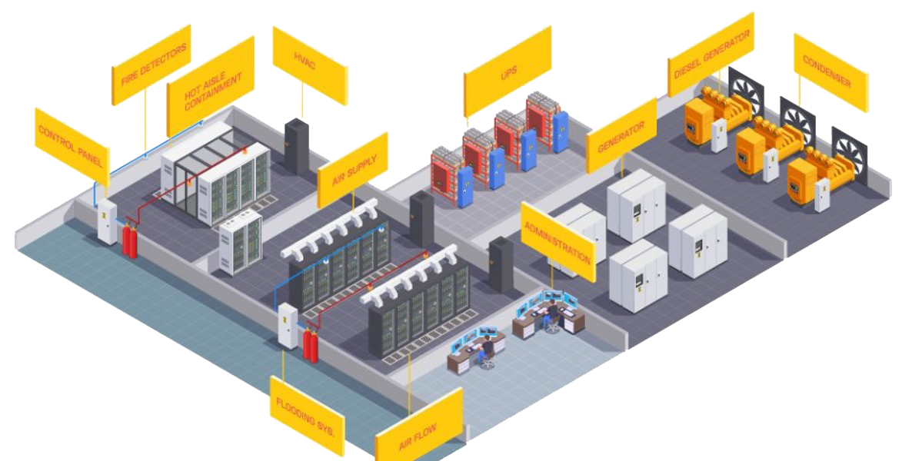
KEEPING IT OPERATIONAL
Behind the Racks…
DIESEL
GENERATOR
DATA HALLS
HVAC
BATTERY
PLANT
EXHAUST
AISLE
CONTAINMENT
CONTROL
PANEL
UPS
BUS POWER
24 x 7
SECURITY / NOC
FIRE DETECION /
SUPRESSION
SYSTEMS
DESIGNED TO:
Keep it Operational: Redundant systems, always on, always available, SPOF elimination
Keep it Cool: Aisle containment & cooling
Keep it Secured: Controlled access, cameras, 2-factor authentication, biometrics, weight sensors
LEAK
DETECTION
SYSTEMS
AIR FLOW

Slide 14
KEEPING IT COOL
Computers Generate a Lot of Heat…
Hot Aisle
Cold Aisle
Hot Aisle
Data Centers use state-of-the-art air control systems to keep the computers running cool.
10 – 1,000 Watt Microwaves/Cabinet
1,667 – 6 Watt LED Light Bulb

Slide 15
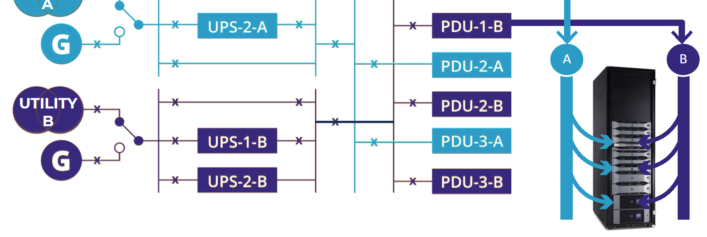
KEEPING IT ON
Power REDUNDANCY…
A sophisticated design of back-up power supplied through battery (UPS) and Generator systems to ensure the lights always stay on.

Slide 16
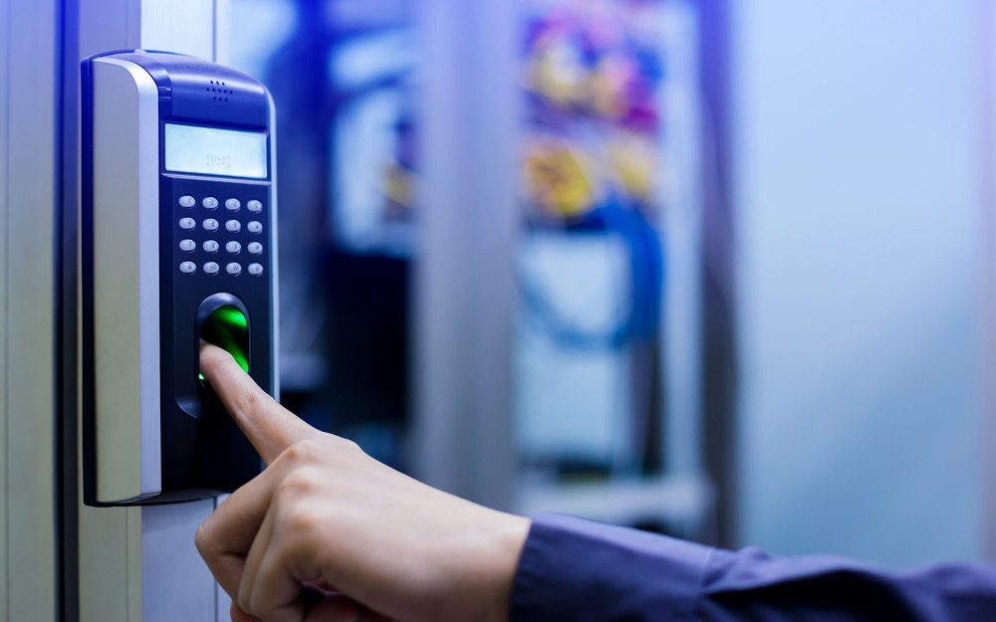
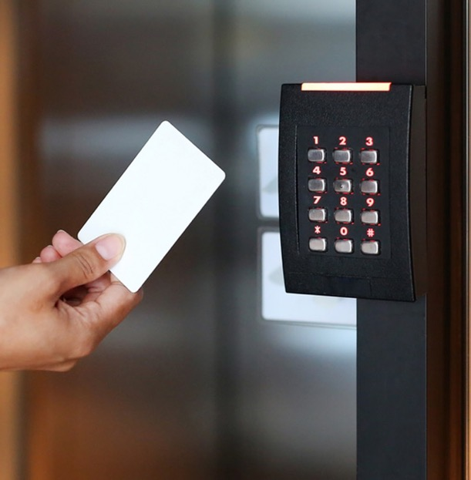
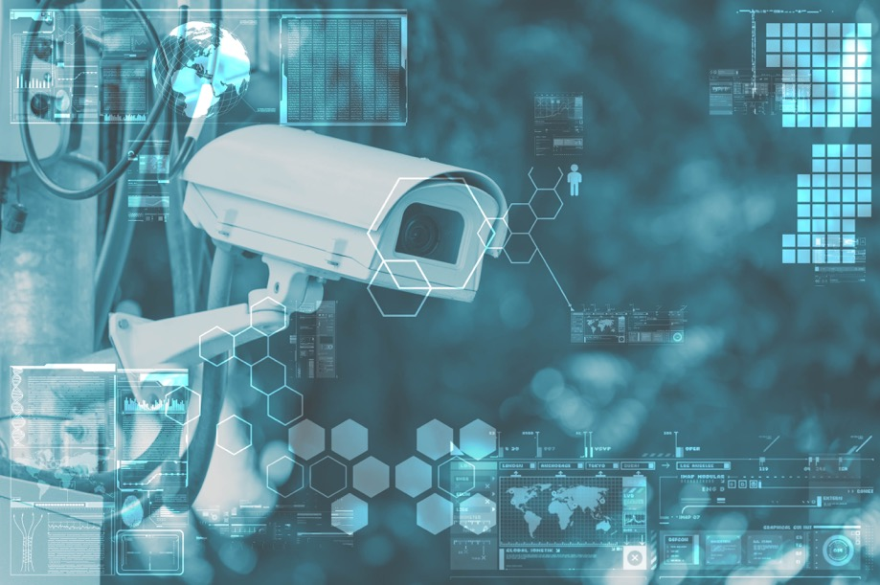
KEEPING IT SECURE
Lights, Cameras, SECURITY…
A combination of security cameras, motion sensors, weight sensors, biometrics, card access control systems, all monitored through a centralized 24/7/365 Security and NOC Team.

Slide 17
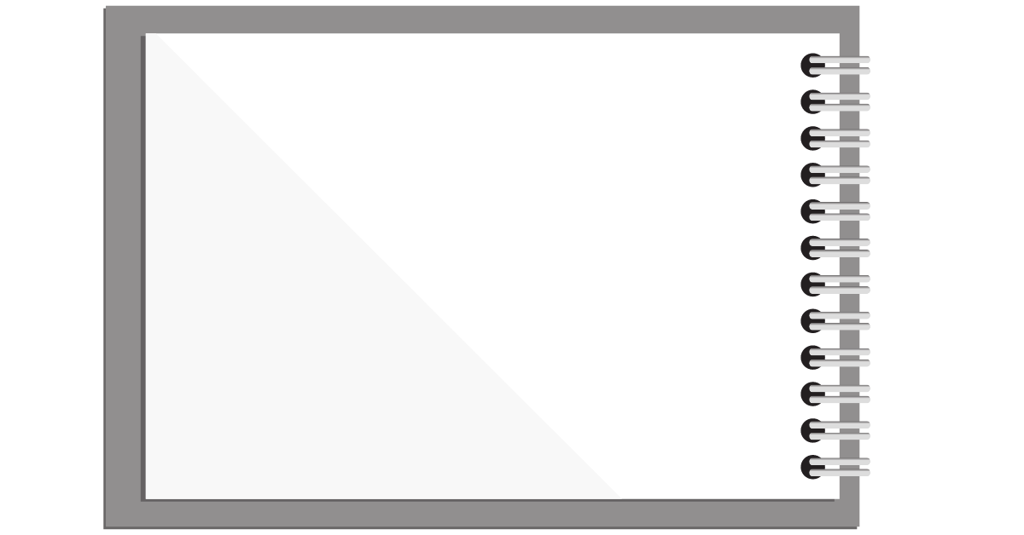


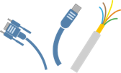
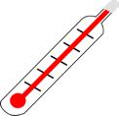



DATA CENTER
NEEDS
Power
High Speed
Cabling
Water
Climate
Electricity
Financial
Support

Slide 18
DATA CENTERS HAVE
CONCERNS

Slide 19





DATA CENTER
CONCERNS
Natural Disasters
Visibility/ Civil Disorder
Nearby Transportation
Friendly Neighbors

Slide 20





SUSTAINABILITY &
ENERGY EFFICIENCY
Notes:
KARL MILLER
LEED Projects
WELL
FitWell
Living Building Challenge
Net Zero Building
Passive House

Slide 21

SUSTAINABILITY &
ENERGY EFFICIENCY
Reduce Energy By:
Water Reduction by:
Increasing the room temperatures
Lower humidity set points or eliminate humidification
Use lighting controls to turn off lights in areas without occupants
High-efficient transformers and UPS modules
LED lighting – targeted locations
Free cooling on the mechanical systems (pumped refrigerant, air or water side)
Use water cooled mechanical equipment
CFD study to determine possible airflow reductions.
Hot/cold aisle containment
Using air cooled equipment
Rainwater harvesting for cooling tower makeup water
Lower humidity set points or eliminate humidification
Notes:
KARL MILLER

Slide 22


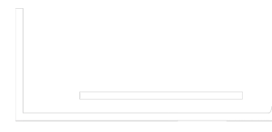
CONSIDER A CAREER IN
DATA CENTERS!

Slide 23
DID YOU KNOW
Most STEM workers have a college degree, but not everyone. 29% of STEM workers have a master’s degree, 36% have a bachelor’s degree, and 35% have less than a bachelor’s degree (associates, some college, or high school)*
During the COVID-19 pandemic, we relied on technology more than ever. Because of this demand, STEM jobs are expected to grow 10.5% between 2020 and 2030*.
The US Dept of Labor projects 12% growth in Computer and IT occupations from 2014 to 2024.
STEM
Science
Technology
Engineering
Mathematics
The number of staff needed to run the world’s data centers will grow by 300k in the next 3 years*. That’s faster than the average for all occupations!
*Sources: Pew Research Center, US Bureau of Labor Statistics, Uptime Institute

Slide 24
HAVE A KNACK FOR…
Hands-on Work:
Software & Computer Skills:
Data Center Technicians
Electrical wiring
Tech configuration
Security system development
Building Engineers
Ensure facilities run efficiently
Work with electricity, automation, power, air & water flow, wiring, etc.
Overall building maintenance
Security
Keep buildings and computers safe
IT Specialist
Tech support and network maintenance
Cyber security
Digital Content Creator
Promote company brand
Manage and expand social media presence
Maintain company website
Utilize SEO to increase traffic to company sites
Programmer
Write coding
Create apps
Notes:
KARL MILLER

Slide 25
HAVE A KNACK FOR…
Math/Money Management:
Negotiation/Interpersonal Skills:
Accounting and Financial Planning
Money management
Financial reporting and budgeting
Accounts Receivable Specialist
Expense tracking
Maintain records of payment and collections
Property Management
Real estate
Tenant contracts and legal documents
Business Development
Sales
Building and maintaining customer relationships
Marketing
Event planning
Develop and distribute company promotional materials
Organize networking events
People Operations
Recruiting and Benefits
Culture and Inclusion
Workforce development and training
Notes:
KARL MILLER

Slide 26
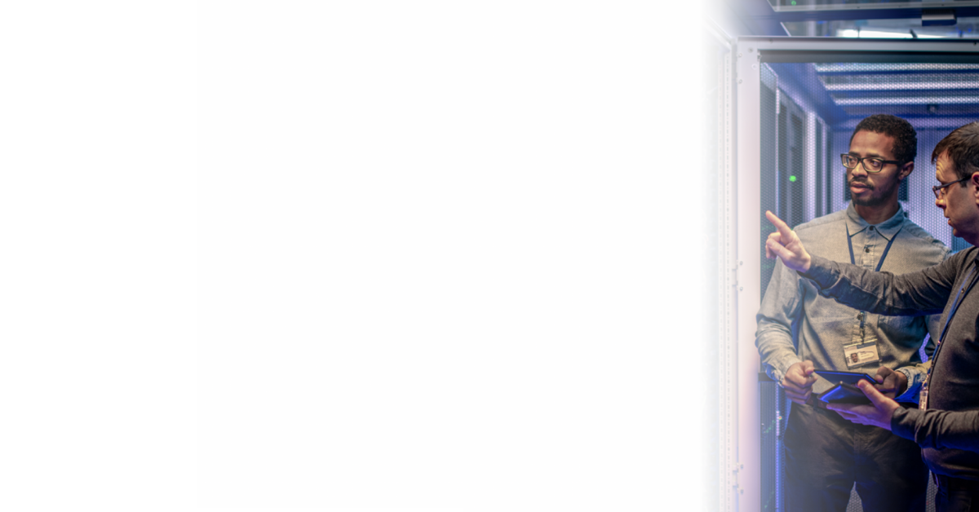
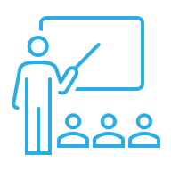



HOW TO PREPARE
COURSES
CAREER PREPARATION
AutoCAD and shop courses
Excel and computer science courses
STEM Courses
Build your resume – many free tools online!
Join LinkedIn
Free interest-specific LinkedIn courses
Seek out internship opportunities
HIGHER EDUCATION
MENTORSHIP/CLUBS
Bachelor’s degree for careers in accounting, business
Associates degree for careers in engineering, computer science
Not required for most careers in technician work, security, and IT
Interest-specific school clubs
Seek out mentorship opportunities with teachers in subject of interest
Meet with guidance counselor or advisor
Computer/IT groups

Slide 27
SUSTAINABILITY &
ENERGY EFFICIENCY
Reduce Energy By:
Water Reduction by:
Increasing the room temperatures
Lower humidity set points or eliminate humidification
Use lighting controls to turn off lights in areas without occupants
High-efficient transformers and UPS modules
LED lighting – targeted locations
Free cooling on the mechanical systems (pumped refrigerant, air or water side)
Use water cooled mechanical equipment
CFD study to determine possible airflow reductions.
Hot/cold aisle containment
Using air cooled equipment
Rainwater harvesting for cooling tower makeup water
Lower humidity set points or eliminate humidification
Notes:
KARL MILLER

Slide 28
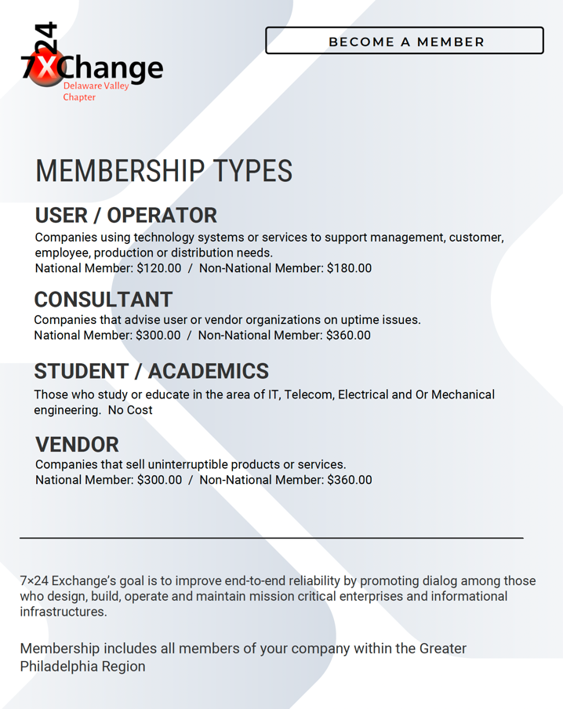

7x24
EXCHANGE
MEMBERSHIP
Mentor Program: https://www.7x24exchange.org/member-resources/mentoring/

Slide 29
IN SUMMARY
Apps store their information in Data Centers.
Companies store their data in Data Centers.
Data Centers are secure.
Data Centers use cutting edge equipment.
There are Data Centers all over the World.
All of these Data Centers help to support “the cloud.”
Data Centers are cool places to work.
There are many career opportunities in Data Centers.

Slide 30
CLASS DISCUSSION
What do you think it would be like to work in a Data Center?
If you had to build a Data Center, where would you build it and why there?
How important are Data Centers in our everyday lives?
What would your Data Center look like?
What job would you want in a Data Center?

Slide 31
